Slide 1
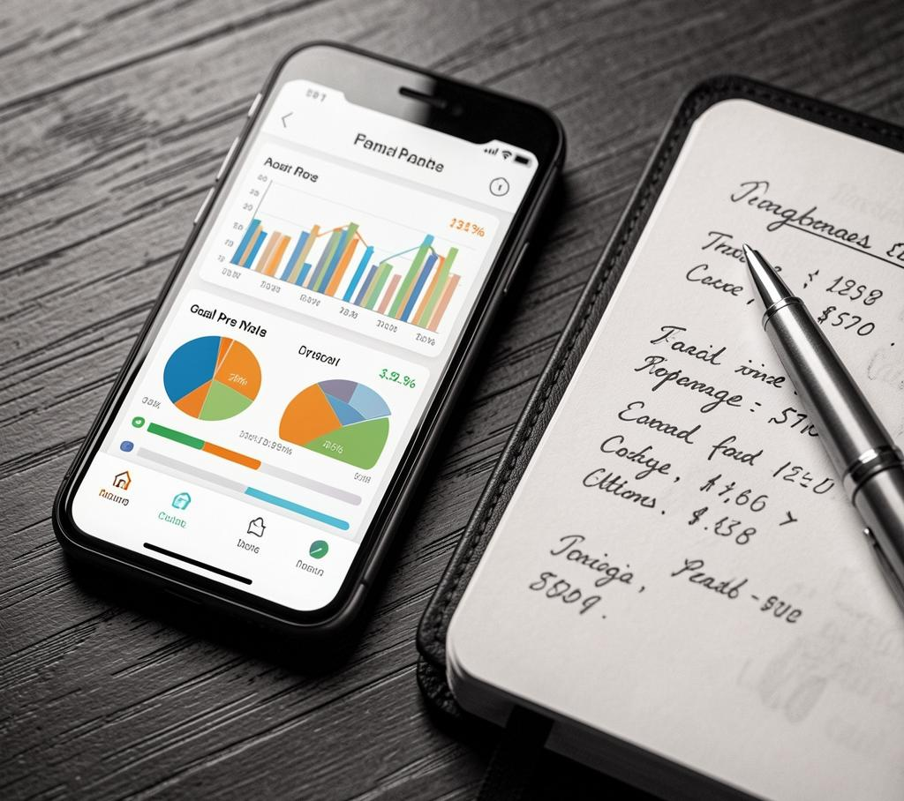
Smart Budget
Track Smart, Spend Wise — Personal finance made simple.

Slide 2

Introduction
Take control of your finances with Track Smart, Spend Wise. This web app makes budgeting effortless and motivating for students and professionals alike.
Receive clear insights, set goals, and build lasting saving habits with an intuitive dashboard and smart alerts.

Slide 3
Expense Tracking Gap
Many users lack a simple way to log daily finances, leading to unclear spending patterns.
This app provides automatic tracking, categorized entries, and visual reports to reveal where money goes and reclaim financial clarity.

Slide 4
Overspending Risks
Unmonitored expenses quickly erode savings and cause stress.
Set budgets, get overspend alerts, and follow personalized suggestions to stop leakage and boost long-term financial confidence.

Slide 5
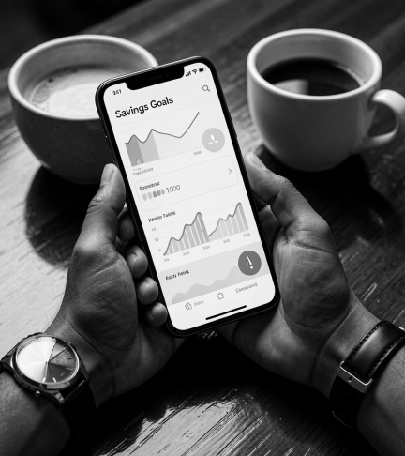
Saving Difficulties
Many struggle to build savings due to irregular tracking and small unnoticed expenses.
Offer clear goals, simple tracking, and gentle nudges to transform habits into lasting savings. Emphasize consistent progress over perfection.

Slide 6
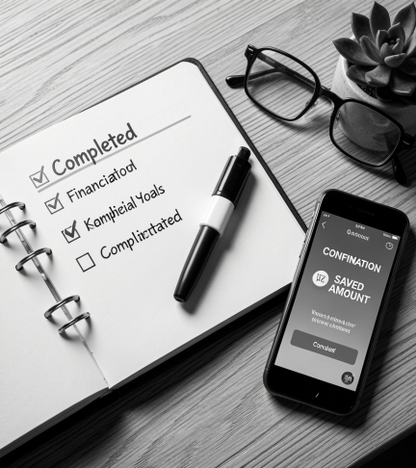
01
Solution & Benefits

Slide 7
Intuitive Dashboard
A clean, visual dashboard shows income, expenses, and balances at a glance.
Users quickly spot trends, set budgets, and act—making better choices with minimal effort and maximum clarity.

Slide 8

Automated Insights
Smart algorithms categorize transactions and highlight anomalies automatically.
Receive actionable tips and timely alerts to prevent overspending and capitalize on saving opportunities.

Slide 9
Long-term Savings
Turn short-term habits into enduring wealth with goal tracking and progress milestones.
Celebrate wins, adjust plans, and watch small changes compound into significant financial security.

Slide 10
Conclusions
Empower users to control money, reduce stress, and build a secure future.
With intuitive tools, automated insights, and goal-focused features, the app converts intention into real financial progress.

